Slide 1

User guide to Maintenance
By: Tyler Gaudin

Slide 2
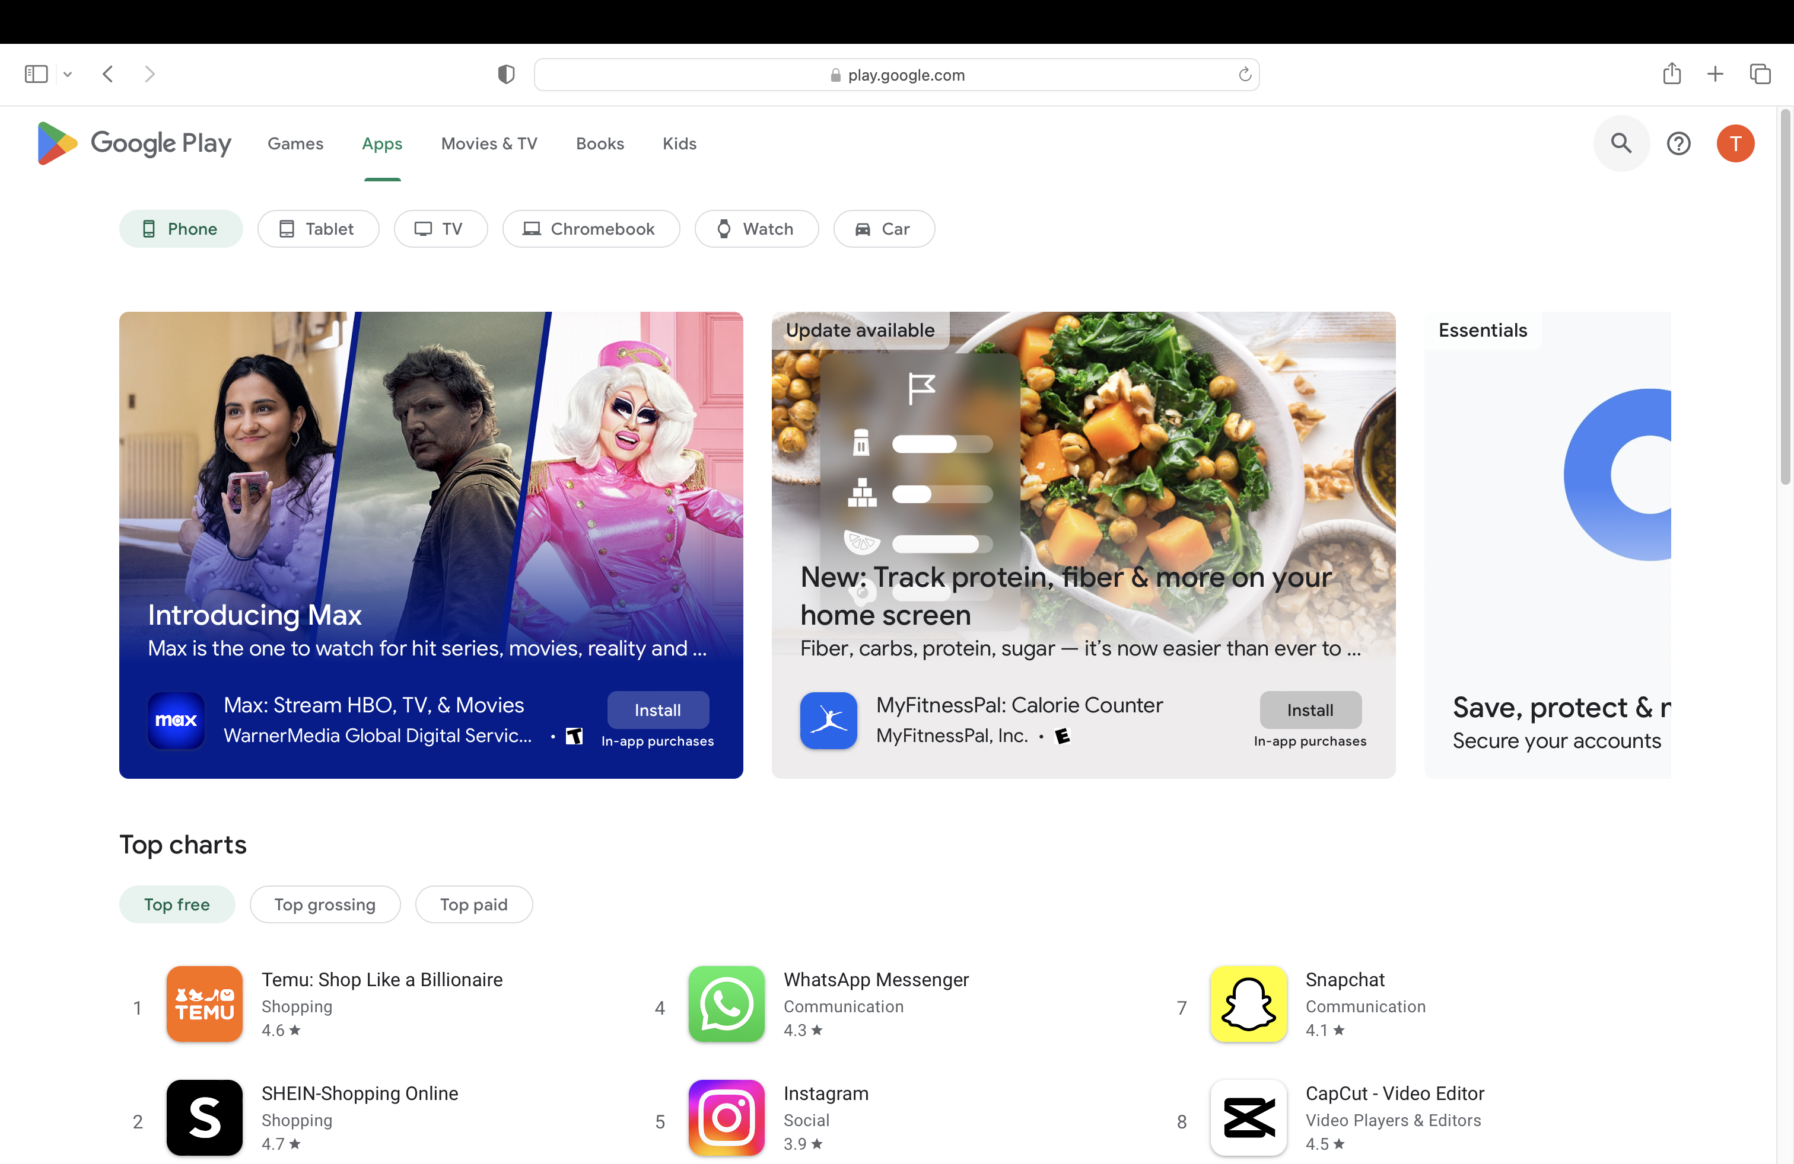
Download the app
Download the application from the Google Play store.
Credit: play.google.com

Slide 3
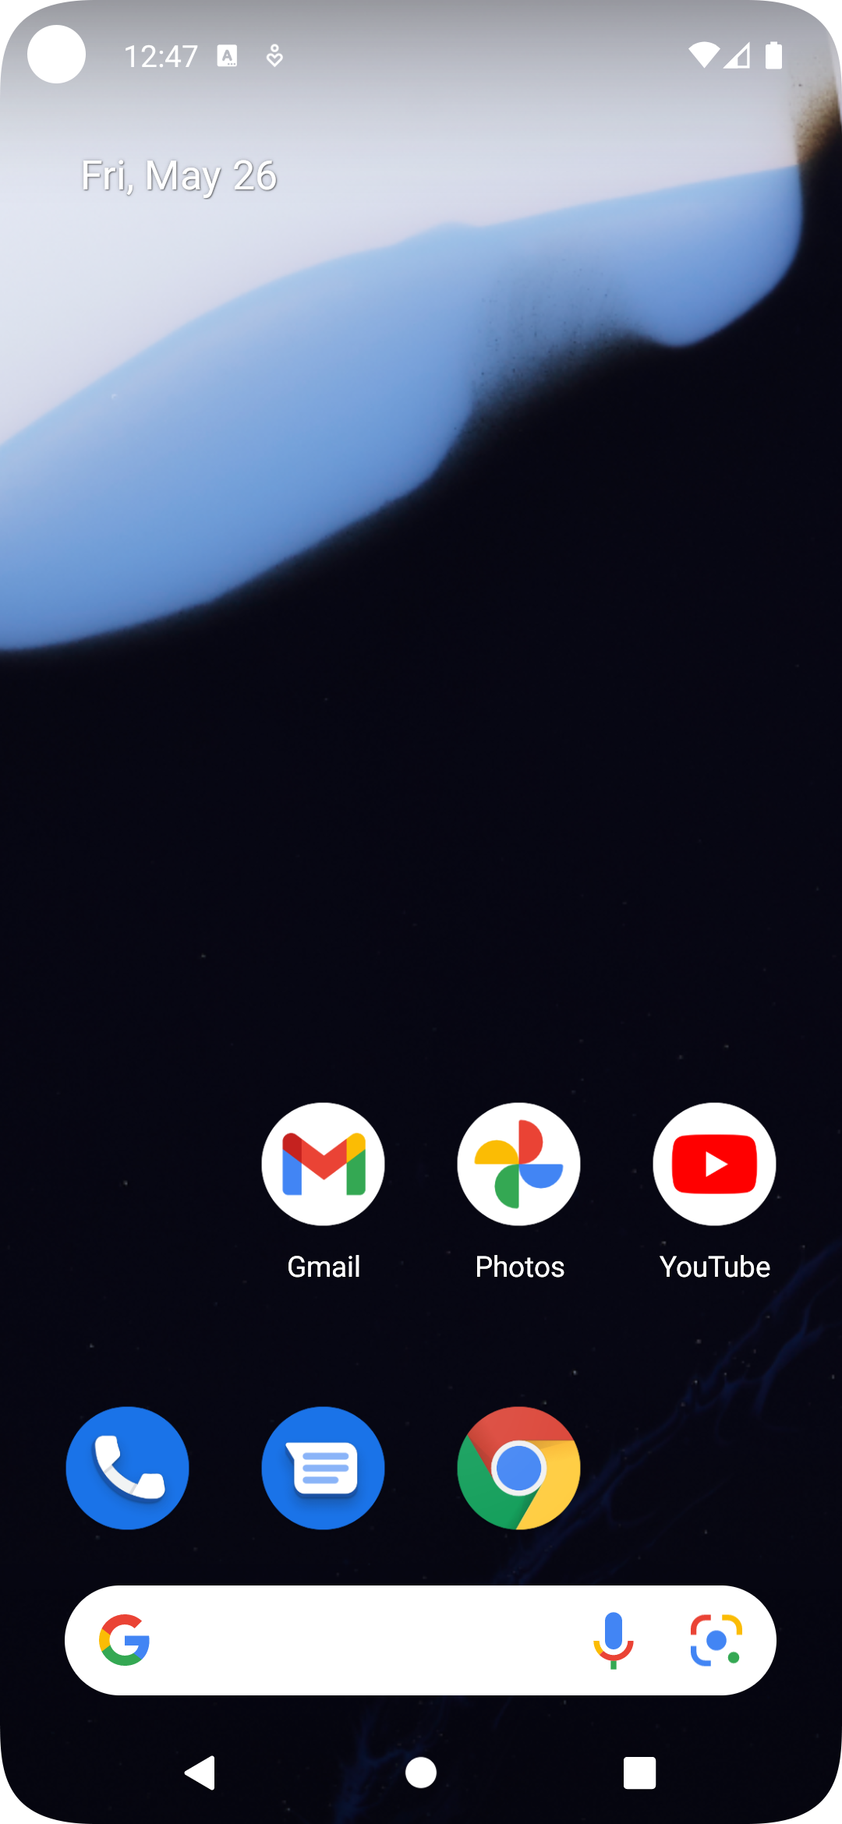
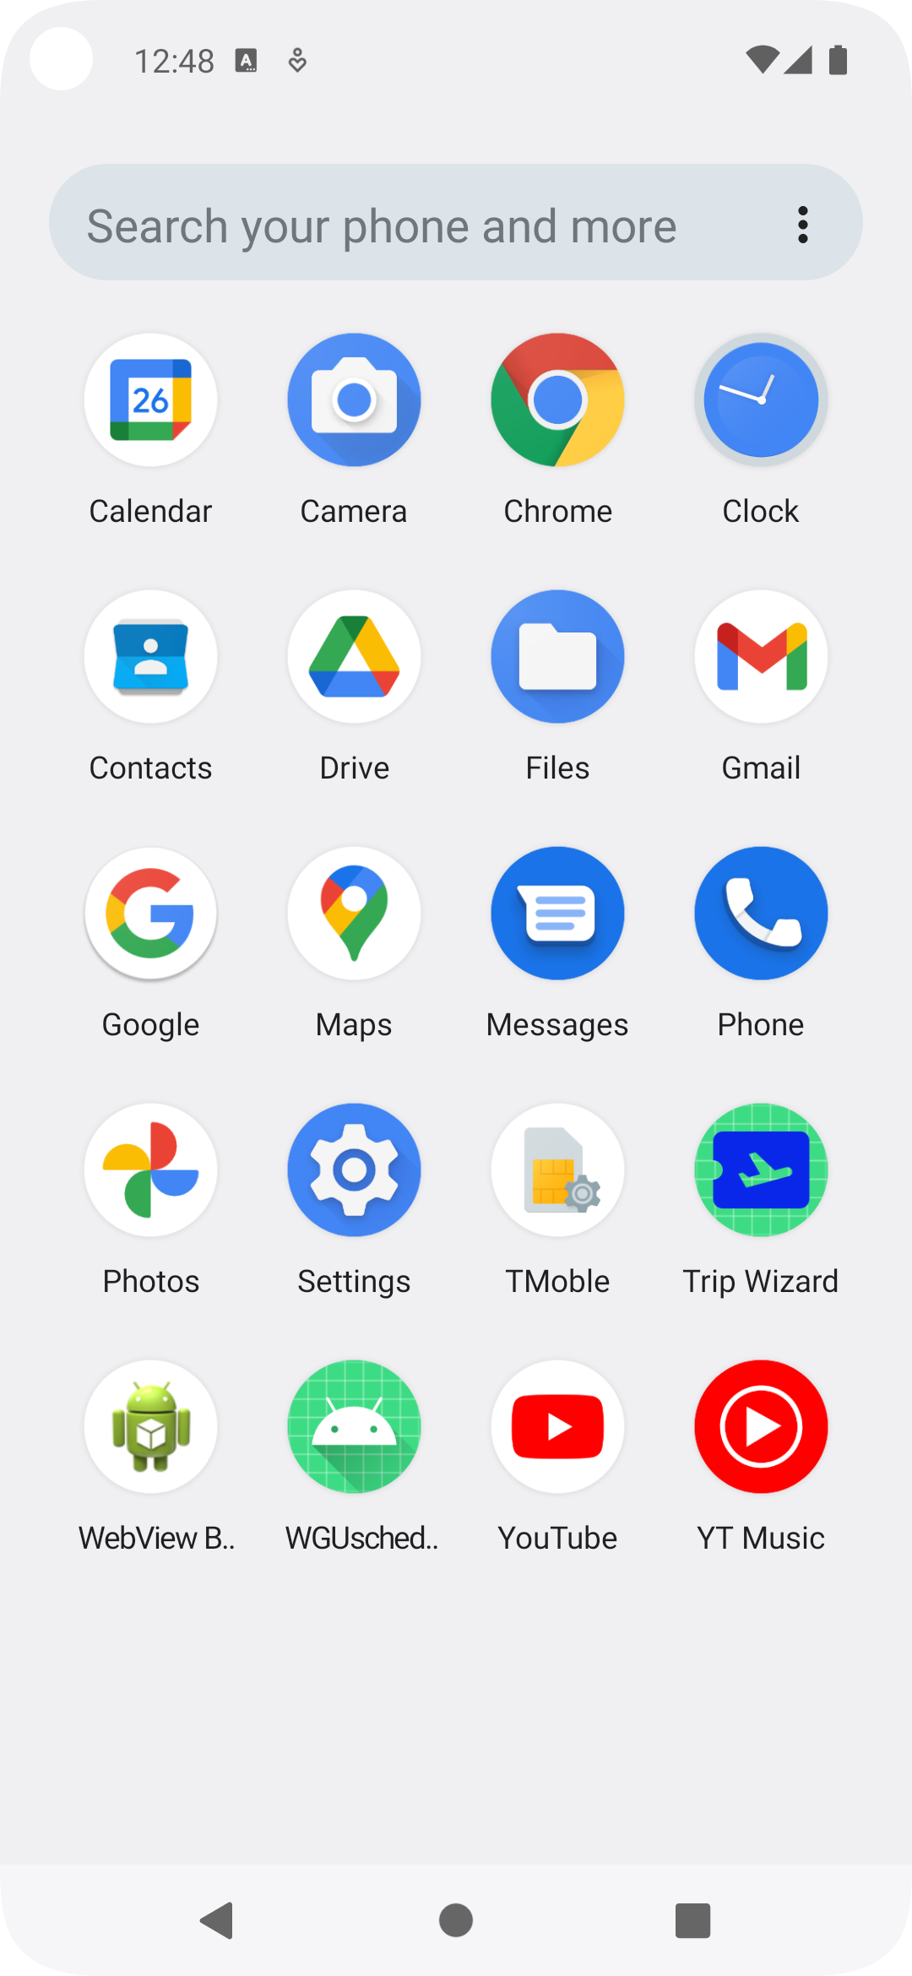
Run the app
Then:
Tap
Tap

Slide 4
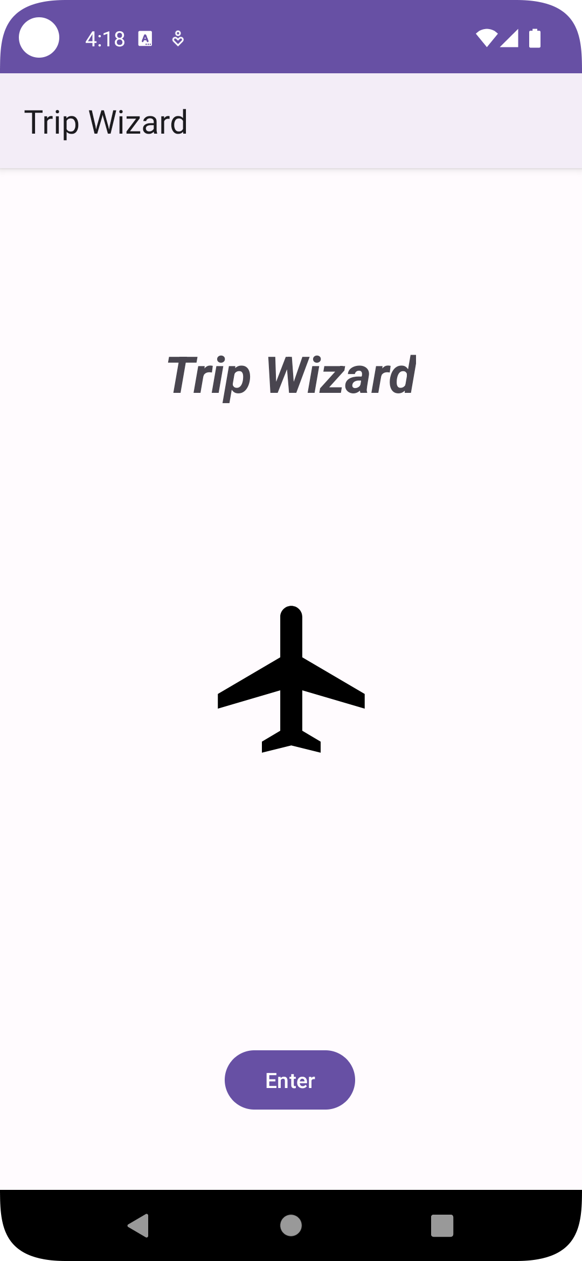
Home Screen
The application opens on this home screen.
User presses enter button
to go to the vacation list.

Slide 5
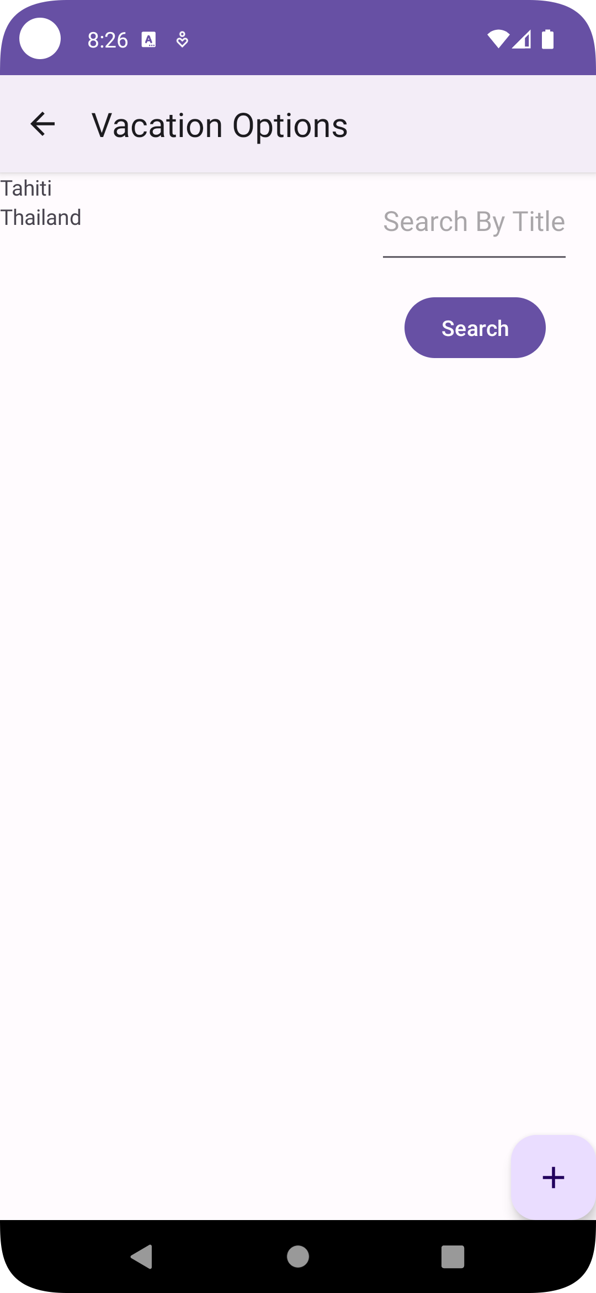
Vacation list
Returns to Home Screen
The user can also search vacations by typing a vacation title in the search bar then tapping the search button.
The application then opens on the vacation list screen. Vacations are listed here. The user selects a vacation to edit.
The user can also create a new vacation by clicking the floating action button.

Slide 6
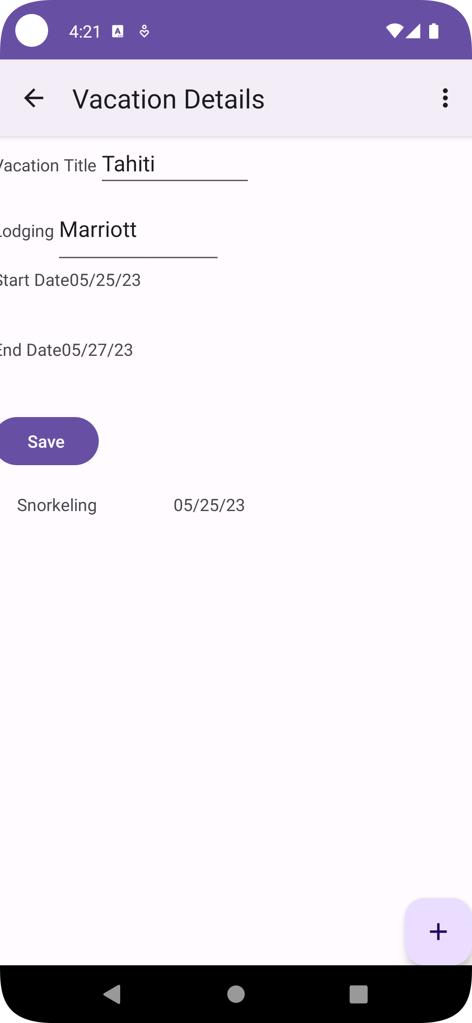
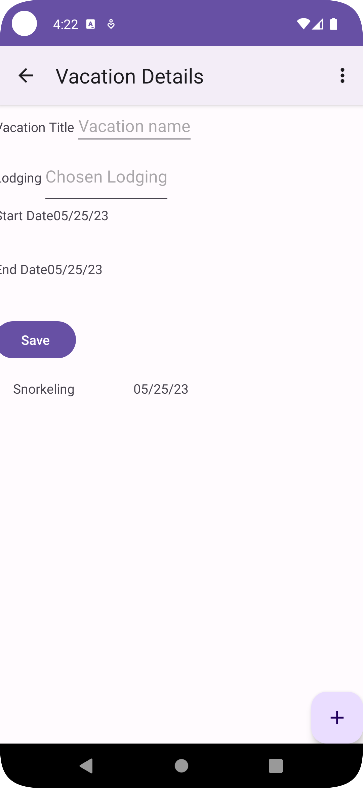
Vacation Details
Returns to Vacation list
Update Vacation
Returns to Vacation list
New Vacation
The application then opens on the vacation details screen. Associated excursions are listed here. The user selects an excursion to edit. Or saves the updates.
The user enters the vacation title and name of their lodging in these fields. The user then saves the new vacation with the save button.
The user can also use the floating action
Button to create a new excursion.
The user can also use the floating action
Button to create a new excursion.
Vacation share, notify start & end date, delete vacation.

Slide 7
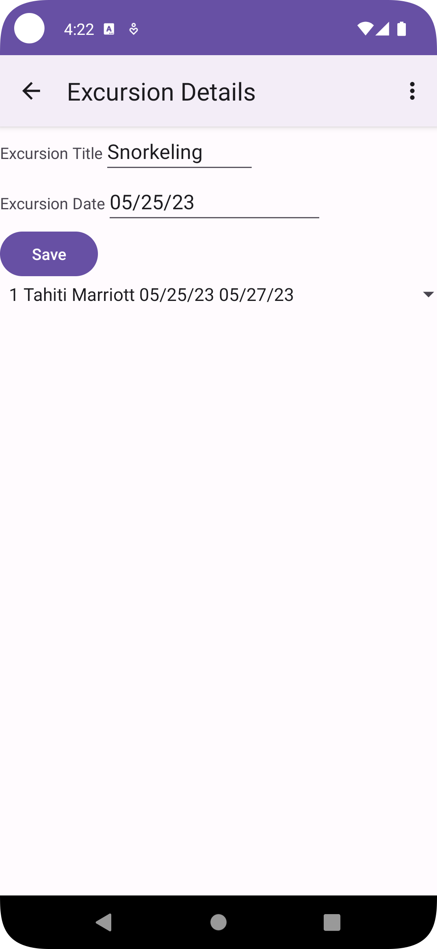
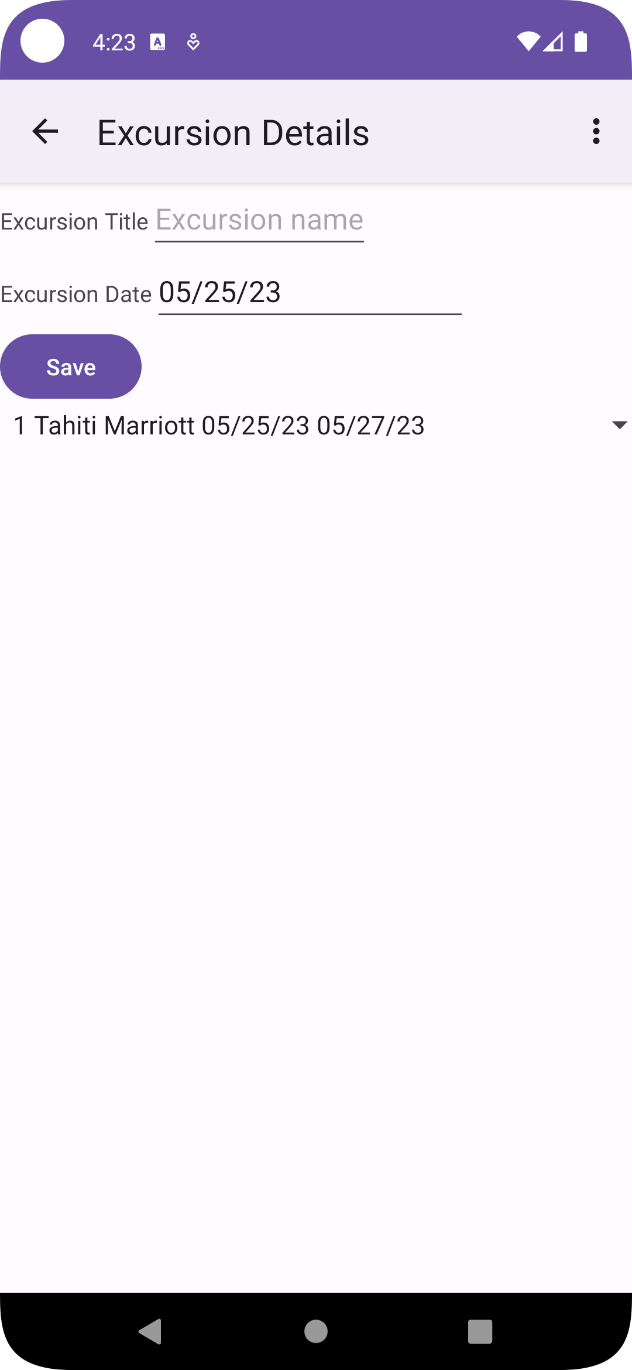
Excursion Details
Returns to Vacation details.
Update Excursion
Returns to Vacation details.
New Excursion
The application then opens on the excursion details screen. The user edits the existing excursion then uses the save button to save the changes.
The application then opens on the excursion details screen. The user creates the new excursion then uses the save button to save the changes.
The user can use the spinner to change the associated vacation
The user can use the spinner to change the associated vacation
The user can click this to open a menu to notify of the excursion date, delete the excursion, or share it.
The user can click this to open a menu to notify of the excursion date, delete the excursion, or share it.

Slide 8
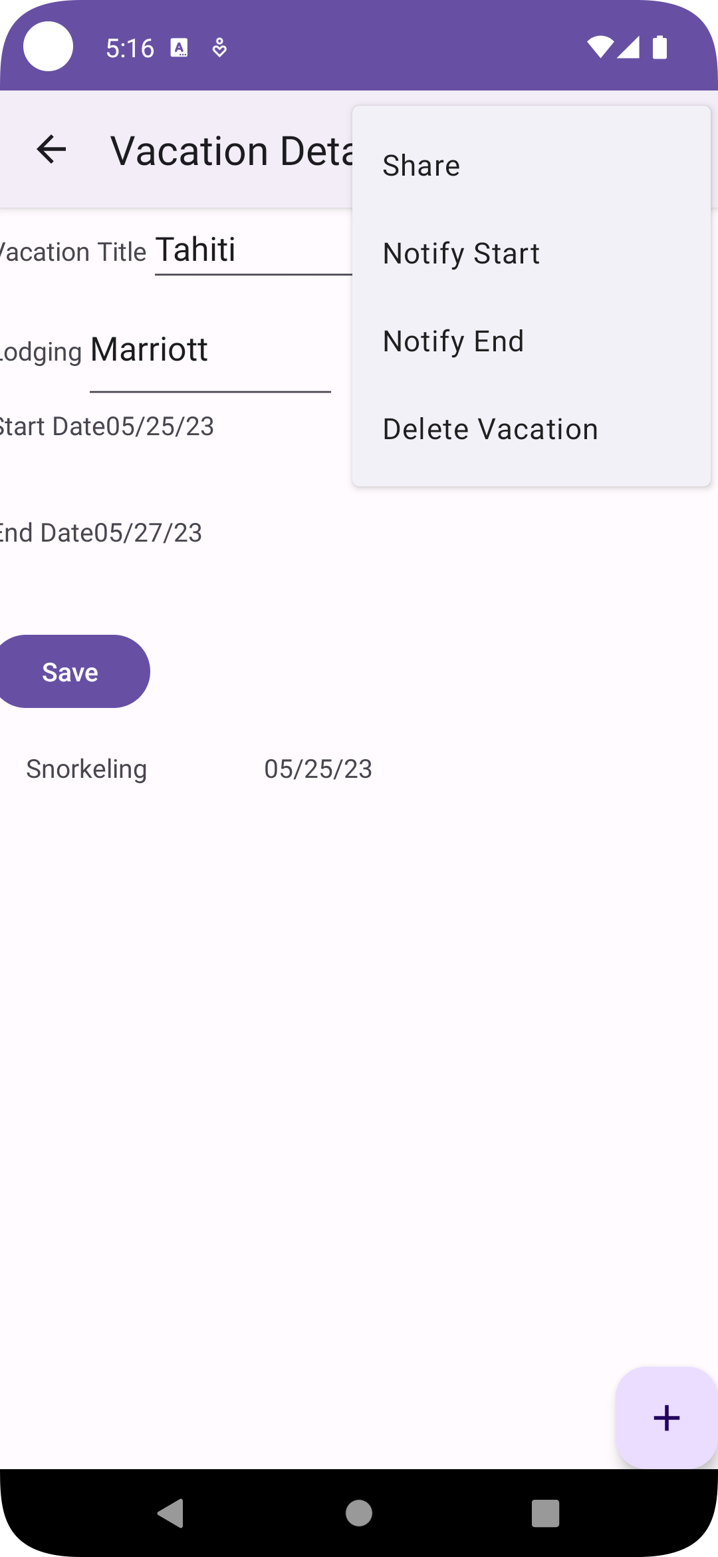
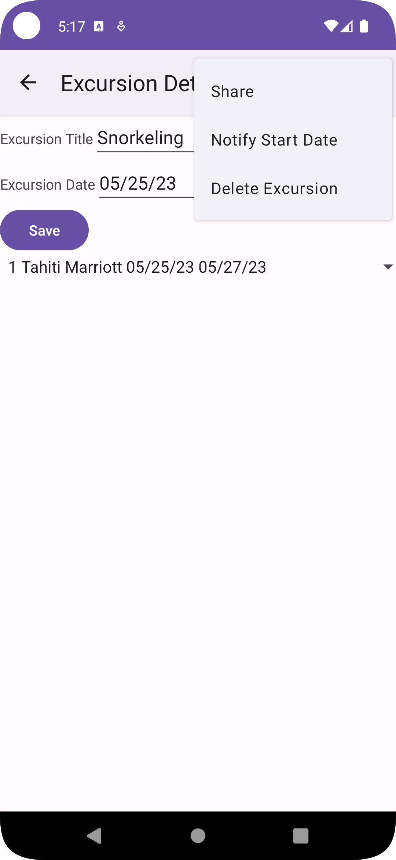
Menu screens
Vacation Details Menu
Excursion Details Menu
The user can choose an option to notify of the vacation date, delete the vacation, or share it.
The user can choose an option to notify of the vacation date, delete the vacation, or share it.

Slide 9
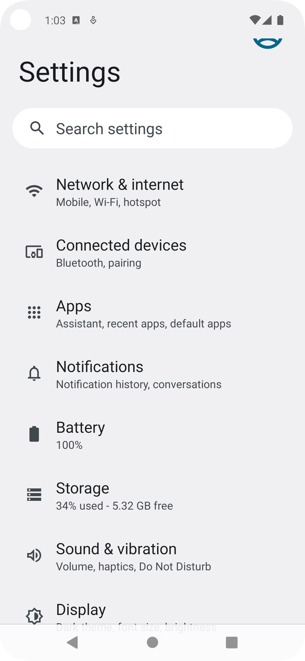
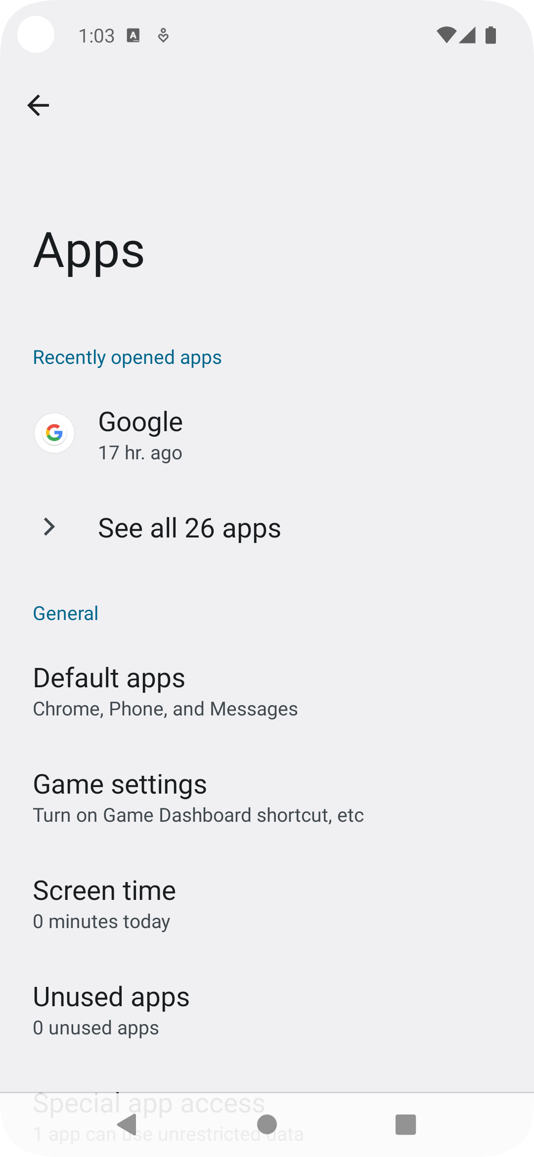
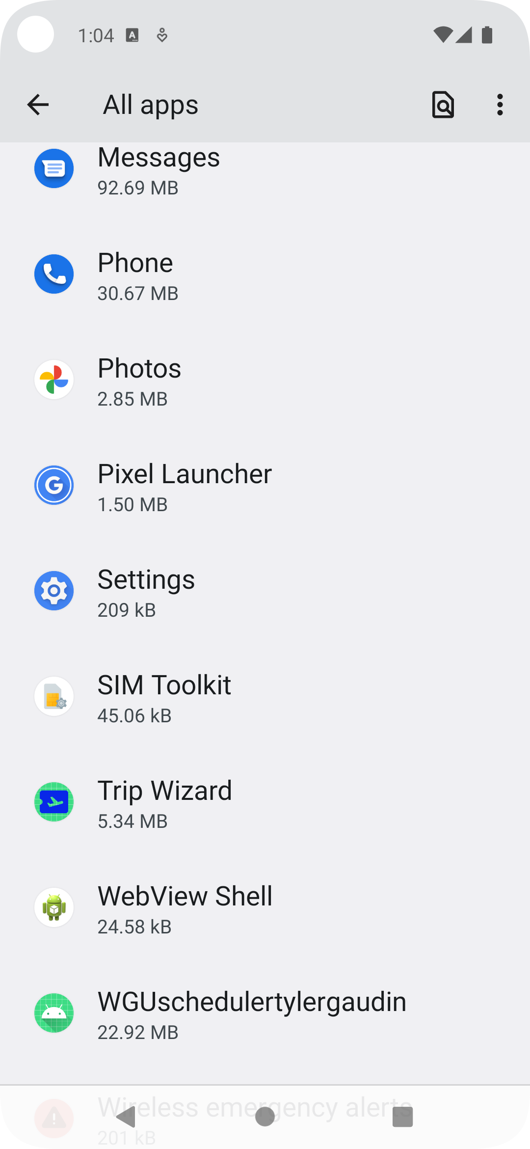
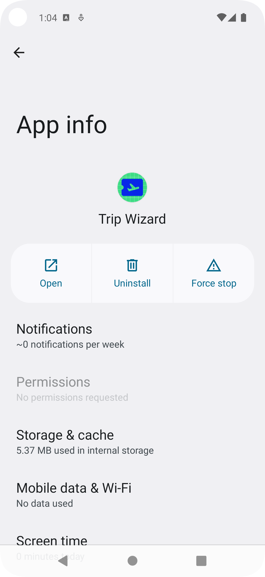
Reset Database
Go to settings and tap Apps.
Tap “See all (number) apps”
Tap the app.
Uninstall the app.

Slide 10
Reset Database (cont.)
Reinstall the application. See slide 2.

